Slide 1
Comparing the Sheep Brain to the Human Brain – A Visual Guide to Use During Sheep Brain Dissection Laboratories
Margarita Bracamonte, Ph.D. Northland Community & Technical College, East Grand Forks, MN

Slide 2
I have edited Dr. Bracamonte’s presentation to better fit our Cameron Human Anatomy course.
- Ron Gaines

Slide 3
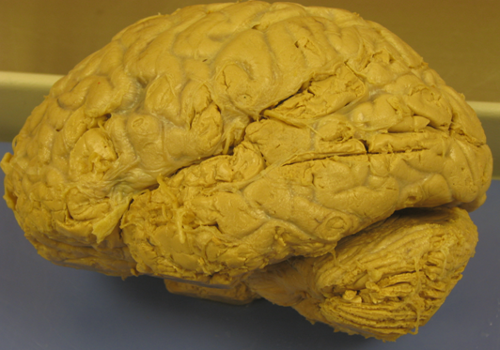
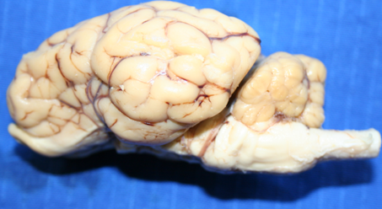
Human Brain
Sheep Brain
Cerebellum
Spinal Cord

Slide 4
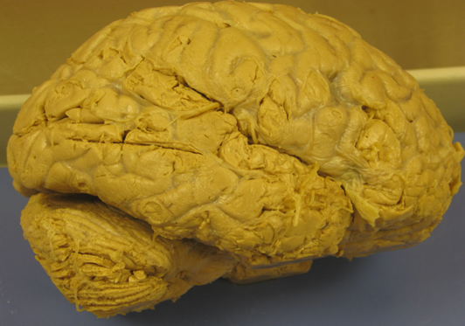
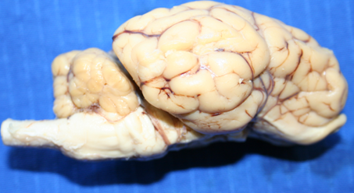
The human brain (and sheep brain) is made up of four parts:
1. Cerebrum
Human Brain
2. Cerebellum
Sheep Brain
Continues…

Slide 5
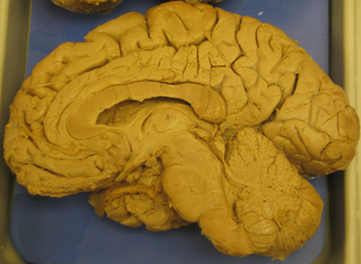
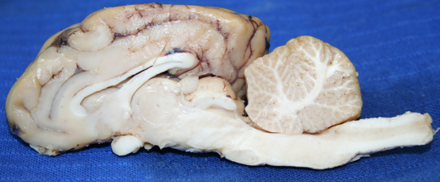
Midsagittal Section
3. Diencephalon
4. Brainstem
Human Brain
Sheep Brain
4. Brainstem

Slide 6
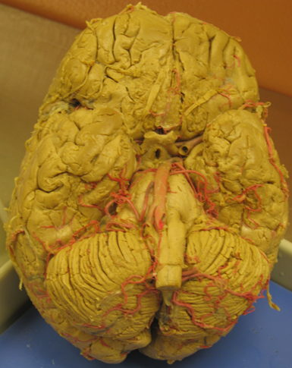
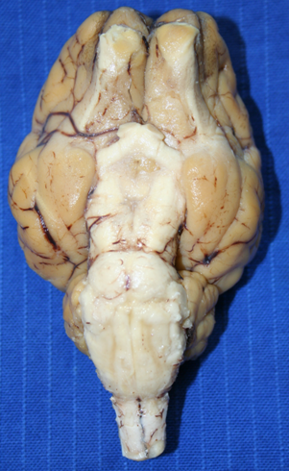
Ventral View
Human Brain
Sheep Brain
Spinal Cord
Spinal Cord
Brainstem

Slide 7
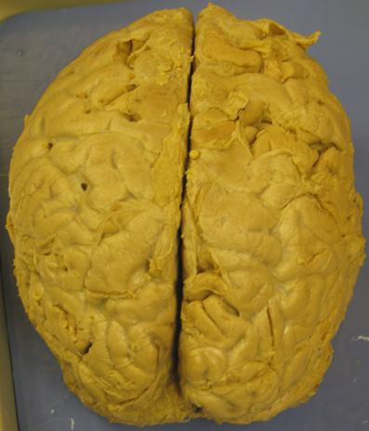
Structures found in the Cerebrum
Cerebrum
Sheep Brain
Human Brain
Superior View

Slide 8
Cerebrum – Superior View
Longitudinal Fissure
Sheep Brain
Human Brain

Slide 9
Cerebrum
Human Brain – Right Lateral View
Transverse Fissure
Sheep Brain – Superior View

Slide 10
Cerebrum
Gyri (Gyrus – Singular)
Sheep Brain – Superior View
Human Brain – Lateral View

Slide 11
Cerebrum
Sulci (Sulcus – Singular)
Sheep Brain - Superior
Human Brain – Left Lateral View

Slide 12
Cerebrum – Midsagittal View
Sulci - shallow groves between gyri
Human Brain

Slide 13
Human Brain (Right Lateral View)-Cerebral Lobes
Frontal Lobe
Parietal Lobe
Temporal Lobe
Occipital Lobe

Slide 14
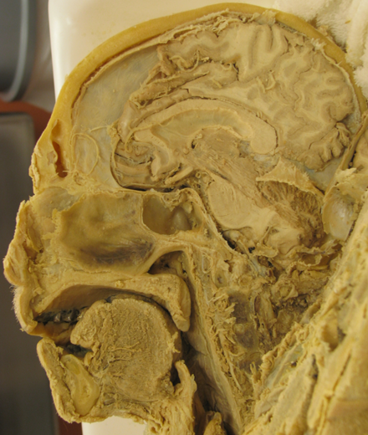
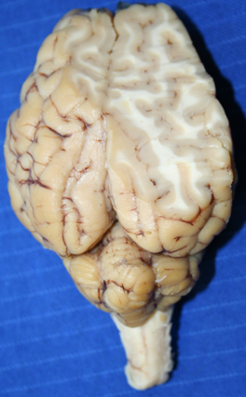
Gray & White Matter of the Cerebrum
Sheep Brain
(Anterior)
Human Brain
Gray
Matter
White
Matter
(Posterior)

Slide 15
Gray Matter = Cerebral Cortex
Human
Brain
Cerebral Cortex
What parts of a neuron are found at the cerebral cortex?

Slide 16
Human
Brain
White Matter
What parts of a neuron are found in cerebral white mater?

Slide 17
Structures found
at the Cerebrum
Corpus Callosum
Human Brain
Midsagittal Section
Sheep Brain

Slide 18
Structures found
at the Cerebrum
Fornix
Human Brain
Midsagittal Section
Sheep Brain

Slide 19
Structures found
at the Cerebrum
Lateral Ventricles
Human Brain
Midsagittal Section
Sheep Brain

Slide 20
Structures found
at the Cerebrum
Third
Ventricle
Human Brain
Midsagittal Section
Sheep Brain

Slide 21
Structures found
at the Cerebrum
Fourth
Ventricle
Human Brain
Midsagittal Section
Sheep Brain

Slide 22
Structures found at the Cerebellum
Human Brain
Cerebellum
Sheep Brain

Slide 23
Midsagittal Section
Human Brain
Human Brain
Cerebellar Cortex
(Gray matter)
What parts of a neuron are found in the cerebellar cortex?
Sheep Brain

Slide 24
Midsagittal Section
Human Brain
Human Brain
Cerebellar white matter (arbor vitae)
What parts of a neuron are found in the arbor vitae?
Sheep Brain

Slide 25
Structures found at the Brainstem
Sheep Brain
Human Brain
Spinal Cord
Spinal Cord
Brainstem
Ventral View

Slide 26
Structures found at the Brainstem
Pons
Spinal Cord
Spinal Cord
Sheep Brain
Human Brain

Slide 27
Structures found at the Brainstem
Medulla
Oblongata
Spinal Cord
Spinal Cord
Sheep Brain
Human Brain

Slide 28
Structures found
at the Brainstem
Midsagittal Section
Human Brain
Midbrain
Sheep Brain

Slide 29
Structures found
at the Diencephalon
Diencephalon
Human Brain
Midsagittal Section
Sheep Brain

Slide 30
Structures found
at the Diencephalon
Thalamus
(mostly intermediate mass)
Human Brain
Midsagittal Section
Sheep Brain

Slide 31
Structures found
at the Diencephalon
Hypothalamus
Human Brain
Midsagittal Section
Sheep Brain

Slide 32
Cranial Nerves – Olfactory Nerve connections
Olfactory Bulbs
Spinal Cord
Spinal Cord
Sheep Brain – Ventral View
Human Brain – Ventral View

Slide 33
Cranial Nerves – Olfactory Nerves
Olfactory Tracts
Spinal Cord
Spinal Cord
Sheep Brain – Ventral View
Human Brain – Ventral View

Slide 34
Cranial Nerves – Optic Nerves
Spinal Cord
Spinal Cord
Sheep Brain
Human Brain

Slide 35
Optic Nerves Cross at Optic Chiasm
Optic Chiasm
Optic Chiasm
Spinal Cord
Spinal Cord
Sheep Brain
Human Brain

Slide 36
Cranial Nerves – Optic Nerves
Optic Tracts
Optic Tracts
Spinal Cord
Spinal Cord
Sheep Brain
Human Brain

Slide 37
Practice your Knowledge of Human Brain Anatomy….
1. Name the cerebral lobe
Anterior
Posterior

Slide 38
Practice your Knowledge About the Human Brain Anatomy….
2. Name this part of the human brain.
Anterior
Anterior
Posterior
Posterior

Slide 39
Practice your Knowledge About the Human Brain Anatomy….
3. Name this part
of the human cerebrum
Anterior
Posterior

Slide 40
Practice your Knowledge About the Human Brain Anatomy….
Inferior view of the human brain.
4. Name this part
of the brainstem

Slide 41
Practice your Knowledge About the Human Brain Anatomy….
5. Name these nerves
Inferior view of the human brain.

Slide 42
Practice your Knowledge About the Human Brain Anatomy….
6. Name this fissure
Anterior
Anterior
7. What fills this fissure?
Posterior
Posterior

Slide 43
Answers
Temporal lobe
Cerebellum
Corpus callosum
Pons
Optic nerves
Transverse fissure
Tentorium cerebelli

