Slide 1
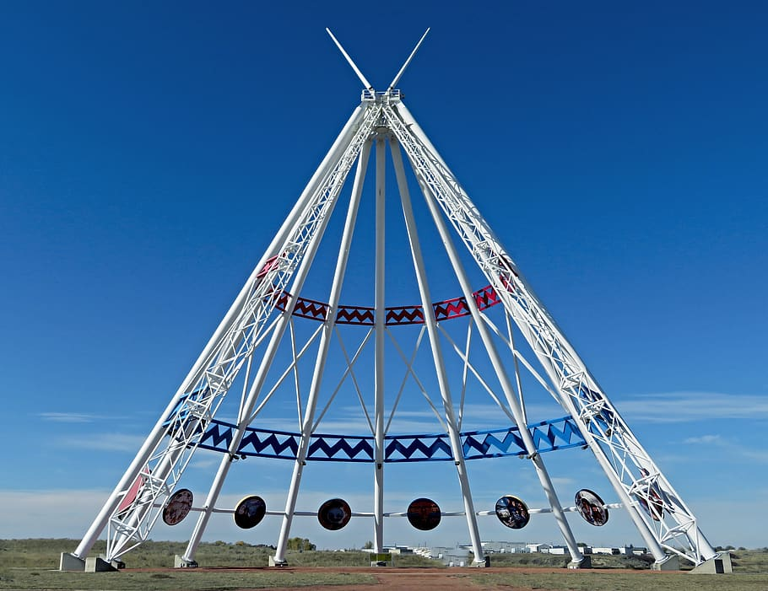
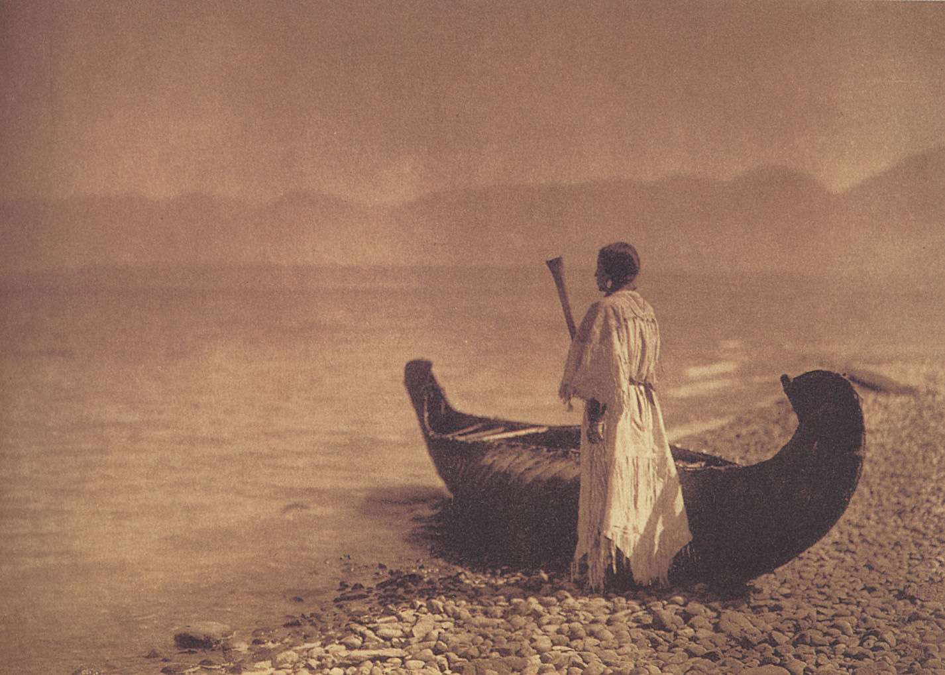
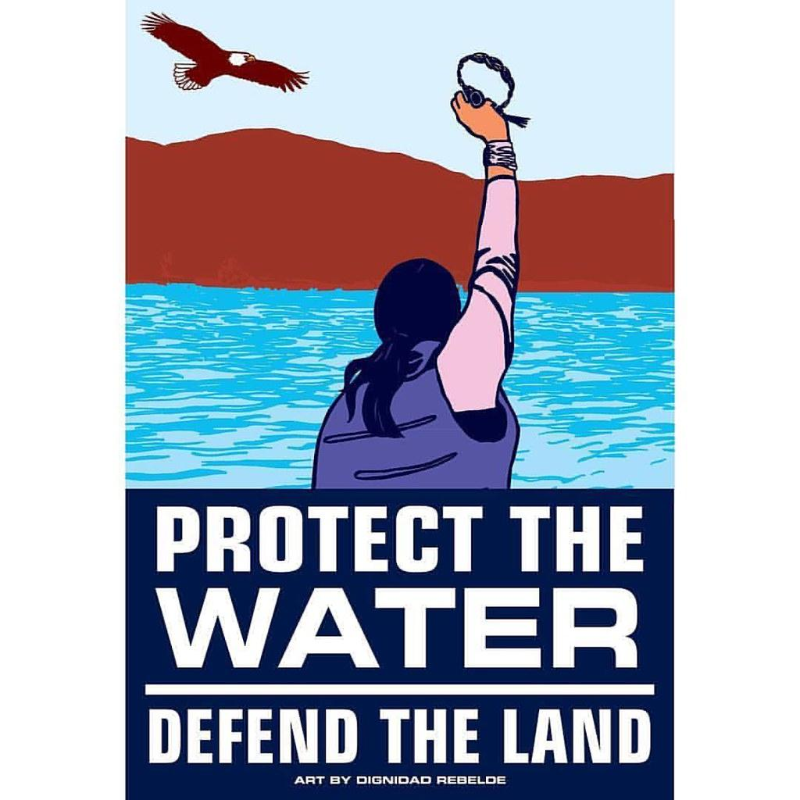
Teaching Indigenous First Nations Science and History
Is American Science and History
Notes:
Whose Land - Treaties and agreements
Native Land Digital - Whose land are you on?
National Museum of the Native American

Slide 2
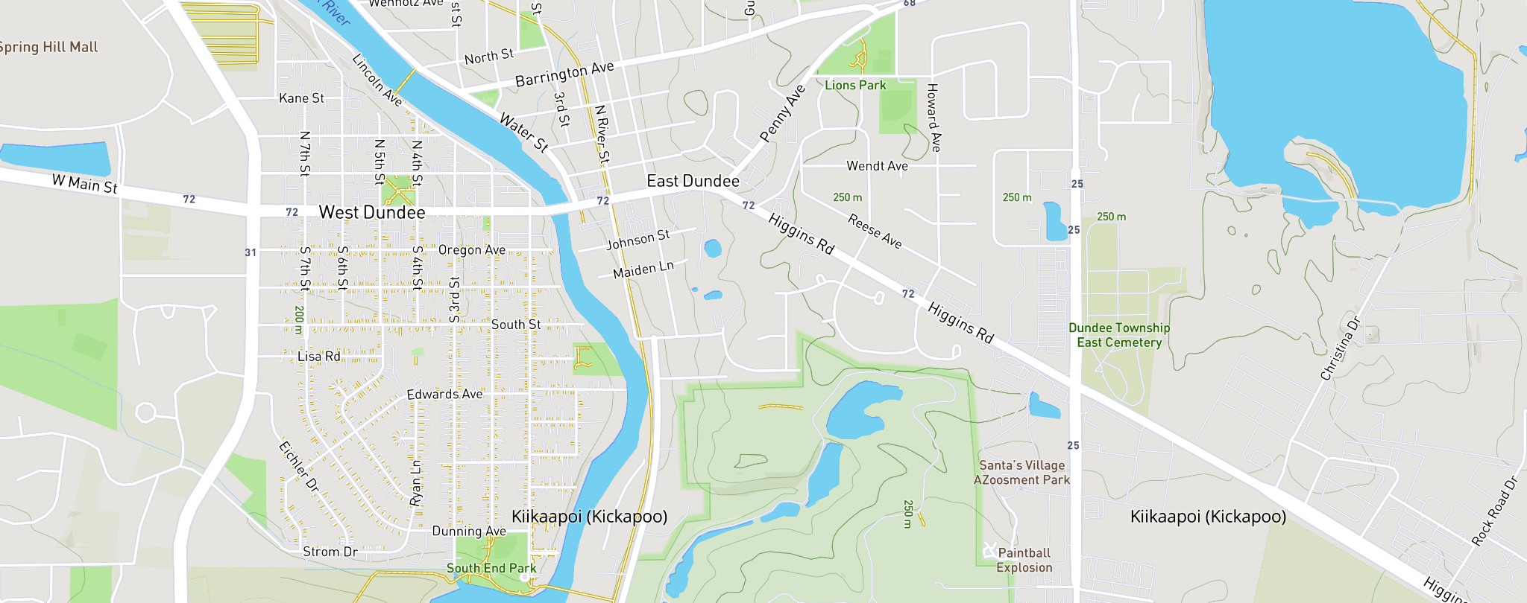
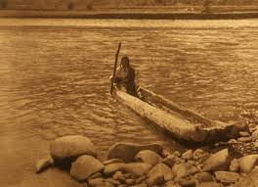
My home is on the unceded land of the Kickapoo (Those who walk the Earth). This obtained from Native Land Digital.
The Kickapoo are Algonquin speaking people.
My home is located near the Fox River on the colonized land of the Kickapoo People. Taken from Native Land Digital.
Notes:
Where I love is on the land of the Kickapoo people.
Native Land Digital

Slide 3
“Aaniin, which can be used as a greeting, conveys acknowledging the light within another person that is the same light within oneself.”
Doctoral Candidate at the University of Wisconsin Stevens Point in Educational Sustainability.
My interests in my research are in Indigenous Science. My philosophy being that there are many voices and ways of learning that have been left out of the public school system that would benefit all living things. That we as humans are part of a natural system that needs respect.
Notes:
Discuss what I teach now and how having been a pre-k teacher informed how I teach high school students.
https://www.thecanadianencyclopedia.ca/en/article/anishinaabemowin-ojibwe-language

Slide 4
Welcome Bozho - Potawatomi and Anishinaabemowin Anamikàge (Welcome) • Algonquins ______________________________________________

Slide 5
President Elect of GLEAMS
Great Lakes Educators of Aquatic and Marine Sciences.
Lake Michigan has always felt like a part of me having been born in Chicago at Edgewater Hospital.
Notes:
Edgewater Hospital no longer there. History of Chicago and the Potawatomi, Sci industry museum, Dusable and his wife founders, Indian Boundary park.

Slide 6
Active Member of Friends of the Fox River. Watershed Warriors- A documentary made with my Environmental Science Students
Notes:
I care about water and live near the river. Being near water calms me.

Slide 7
It’s a new Dawn. It’s a new Day
NOVEMBER 15, 2021 - White House Commits to Elevating Indigenous Knowledge in Federal Policy Decisions
For the first time in more than three decades since its inception, the Intergovernmental Panel on Climate Change (IPCC) mentioned the term “colonialism” in a 2022 report. Leading climate scientists acknowledged that colonialism is a historic and ongoing driver of the climate crisis.Sep 21, 2022
Youth V. Gov – Juliana v. The United States
Notes:
https://news.climate.columbia.edu/2022/09/21/how-colonialism-spawned-and-continues-to-exacerbate-the-climate-crisis/#:~:text=For%20the%20first%20time%20in,driver%20of%20the%20climate%20crisis.

Slide 8
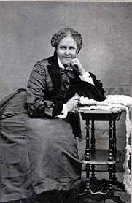
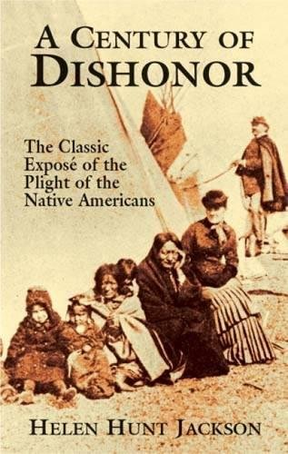
This is Helen Hunt Jackson
She wrote extensively in the late 1800’s about the atrocities and brutalities being done to Native Americans.
This is an example of someone who should be in a textbook.
Notes:
Describe who she is and why she is important.

Slide 9
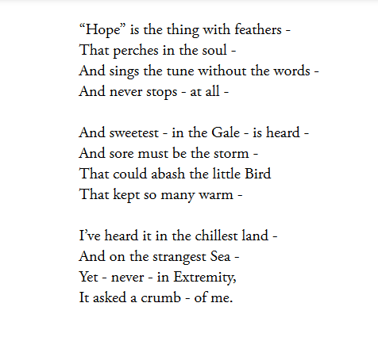
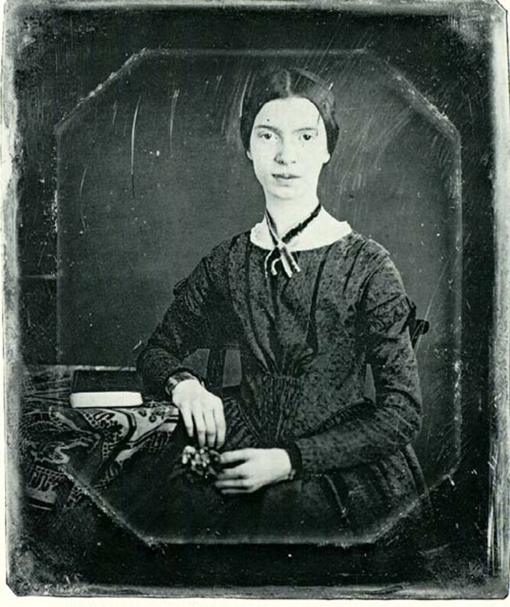
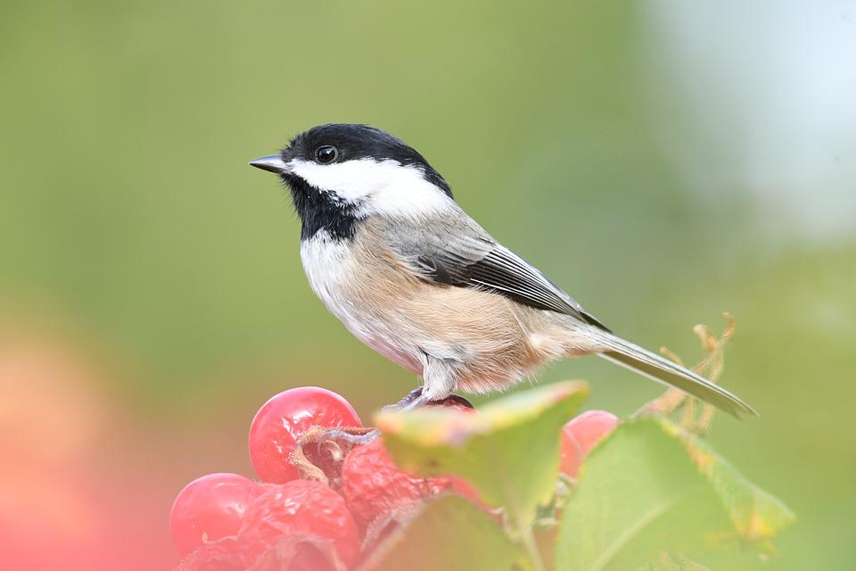
Hope -
Had she been represented by the constitution what would she have contributed?
Notes:
Emily Dickinson. She and Helen were friends.

Slide 10
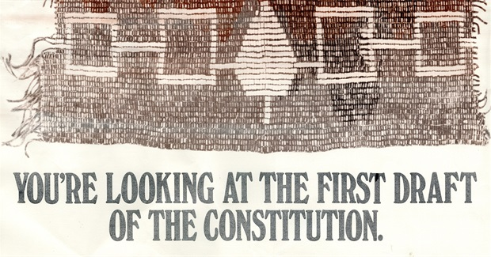
Where did the idea of a democracy come from?
Notes:
Iroquois confederacy. The idea was taken by Ben Franklin and white patriarchy washed.
Wampum is a contract.

Slide 11
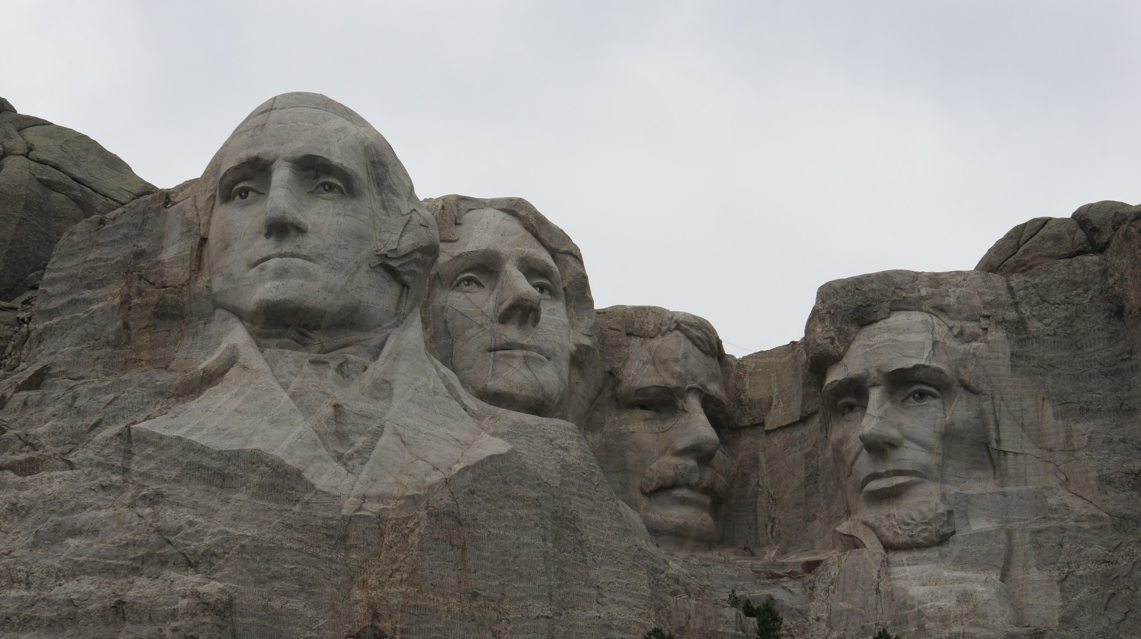
Are these our founding fathers?
Was the country and freedom written for you?

Slide 12
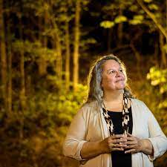
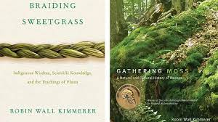
What does Robin WK have to say?
“TEK is increasingly being sought by academics, agency scientists, and policymakers as a potential source of ideas for emerging models of ecosystem management.”
This is from her paper titled;
Weaving traditional ecological knowledge into biological education: a call to action. May 2002, BioScience

Slide 13
Hallie Morrison "Essential Voyage" Indigenous Wisdom Will Save Us All (2022, 20 minute duration)
Indigenous Knowledge Will Save us All
According to Gregory Cajete in Look to the Mountain An Ecology of Indigenous Education
“American education must forge educational processes that are for Life’s Sake and honor the Indigenous roots of America.” (25)

Slide 14
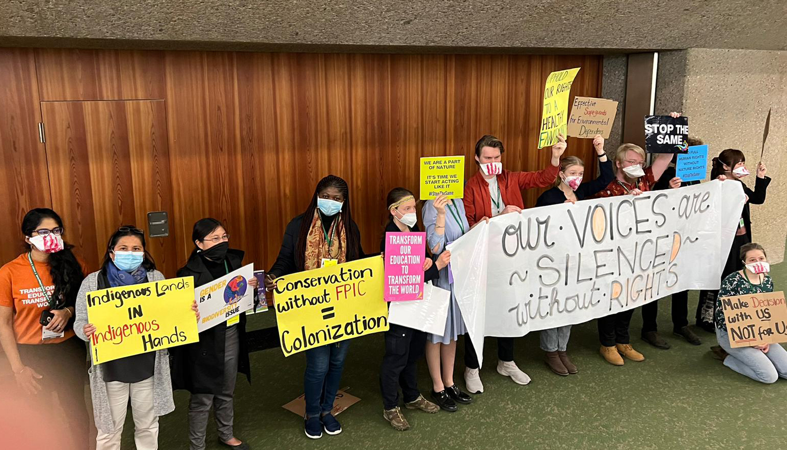
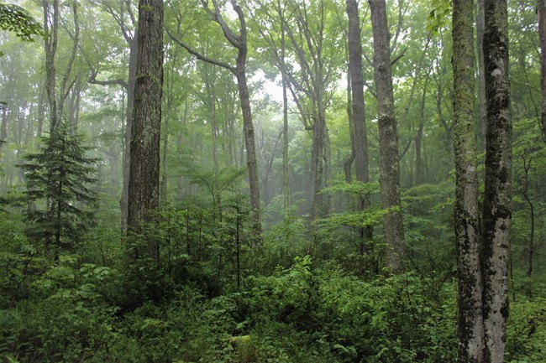
From the Convention of Biological Diversity and Indigenous Peoples
Studies have shown that Indigenous Peoples make up 6.2 percent of the global population and occupy, own, and manage over a quarter of the earth's land surface. Indigenous lands hold around 80 percent of the world’s biodiversity, and Intact Forest Landscapes (IFL) within Indigenous Peoples' lands cover at least 36.2 percent of the world's IFL area.
Schoobio

Slide 15
Working with Local Indigenous People is working with those whose culture is directly connected to the land we live on.

Slide 16
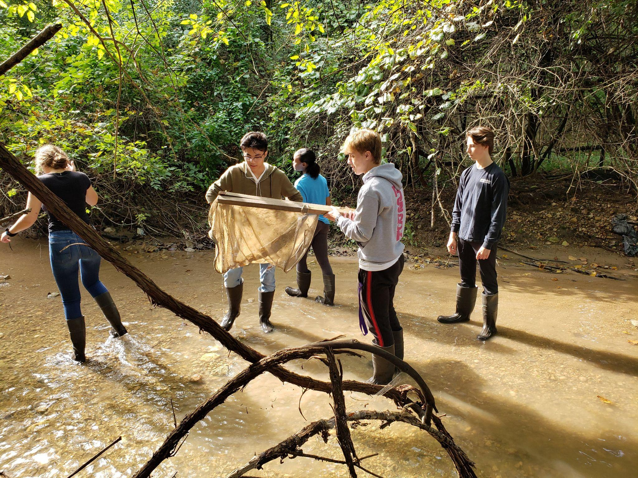
Indigenous Knowledges Can Transform the Future of Public Education.
Indigenous knowledge is a resource that can be used to enhance education rather being studied in a bubble.
Indigenous science puts humans in and part of nature.
Indigenous knowledge is about community with self, society, and nature.
Notes:
Jacob, M. M., Sabzalian, L., Jansen, J., Tobin, T. J., Vincent, C. G., & LaChance, K. M. (2018). The gift of education: how Indigenous knowledges can transform the future of public education. International Journal of Multicultural Education, 20(1), 157–185. https://doi.org/10.18251/ijme.v20i1.1534

Slide 17
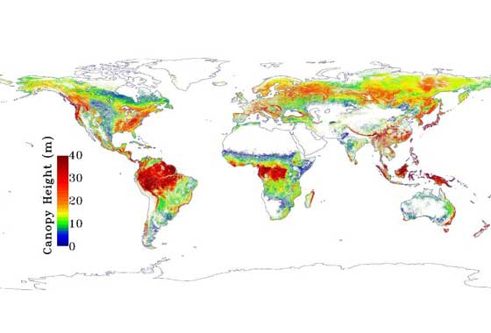
Traditional Ecological Knowledge Co-evolves
Because TEK coevolves with ecological and social systems it can strengthen the capacity of human societies to deal with disturbances and to maintain ecosystem services in change and uncertainty.
Notes:
Gómez-Baggethun, E., Corbera, E., & Reyes-García, V. (2013). Traditional ecological knowledge and global environmental change: Research findings and policy implications. Ecology and Society, 18(4). https://doi.org/10.5751/es-06288-180472

Slide 18
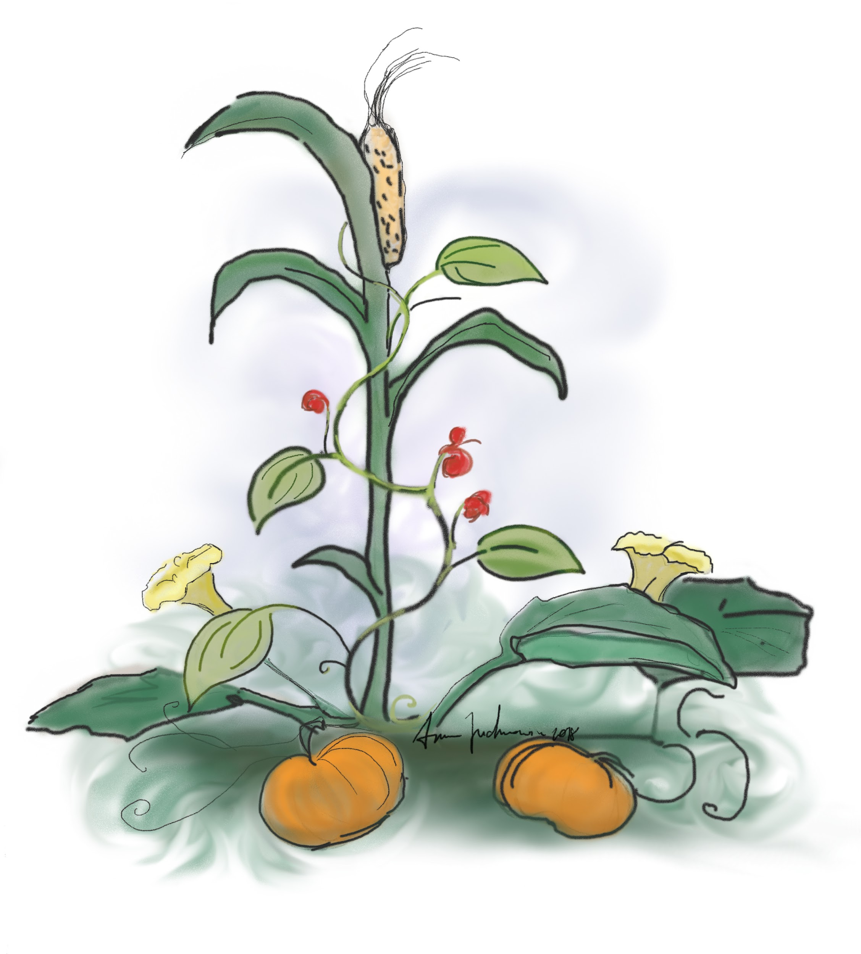
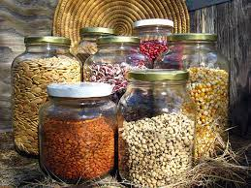
Corn, beans, squash - The 3 sisters
For Thousands of Years, Indigenous Tribes Have Been Planting for the Future
With yields of biodiversity and a more climate-resilient food supply, a movement is sprouting in BIPOC communities across North America to save heirloom seeds and preserve culture.
Notes:
November 30, 2021 S. C. (2021, December 22). For thousands of years, indigenous tribes have been planting for the future. NRDC. Retrieved May 4, 2022, from https://www.nrdc.org/stories/thousands-years-indigenous-tribes-have-been-planting-future

Slide 19
Our paths are joined.
We are made better by seeking to understand each other’s path and learn from each other how to co-create a new and better world.
This land we are on as Americans was taken by those who lived here. They were the founders. It is time that history teaching reaches back into the past for what we can learn from the original founding people.
What would a world that embraces Indigenous Knowledge, TEK, Indigenous Science look like?
Notes:
Discuss the message of finding one’s Indigenous – Winona LaDuke

Slide 20
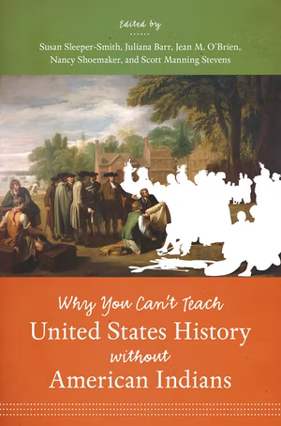
Chicago would not have become what it is without Native Americans.

Slide 21
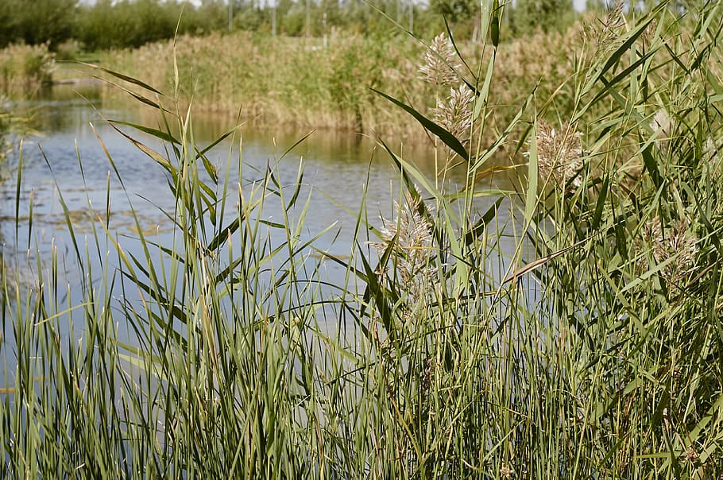
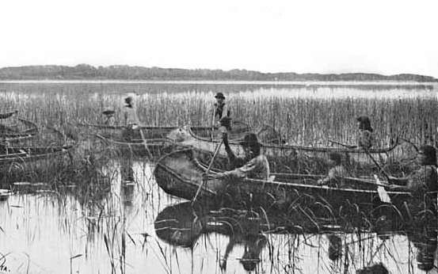
Nature now has a seat at society’s governing bodies thanks to TEK.
The Rights of Nature movement is an “Indigenous idea as it is an outgrowth of the reality that Earth and its many creatures and elements are inextricably connected.” JIm Hightower from the Hightower Lowdown
Notes:
Manoonin - Good berry in Ojibwe 1837 treaty Saving the waters in MN by Manoonin
The Hightower Lowdown vol. 24 Number 1 January 2022 Written by Jim Hightower.
Give Nature a seat at the governing table.

Slide 22
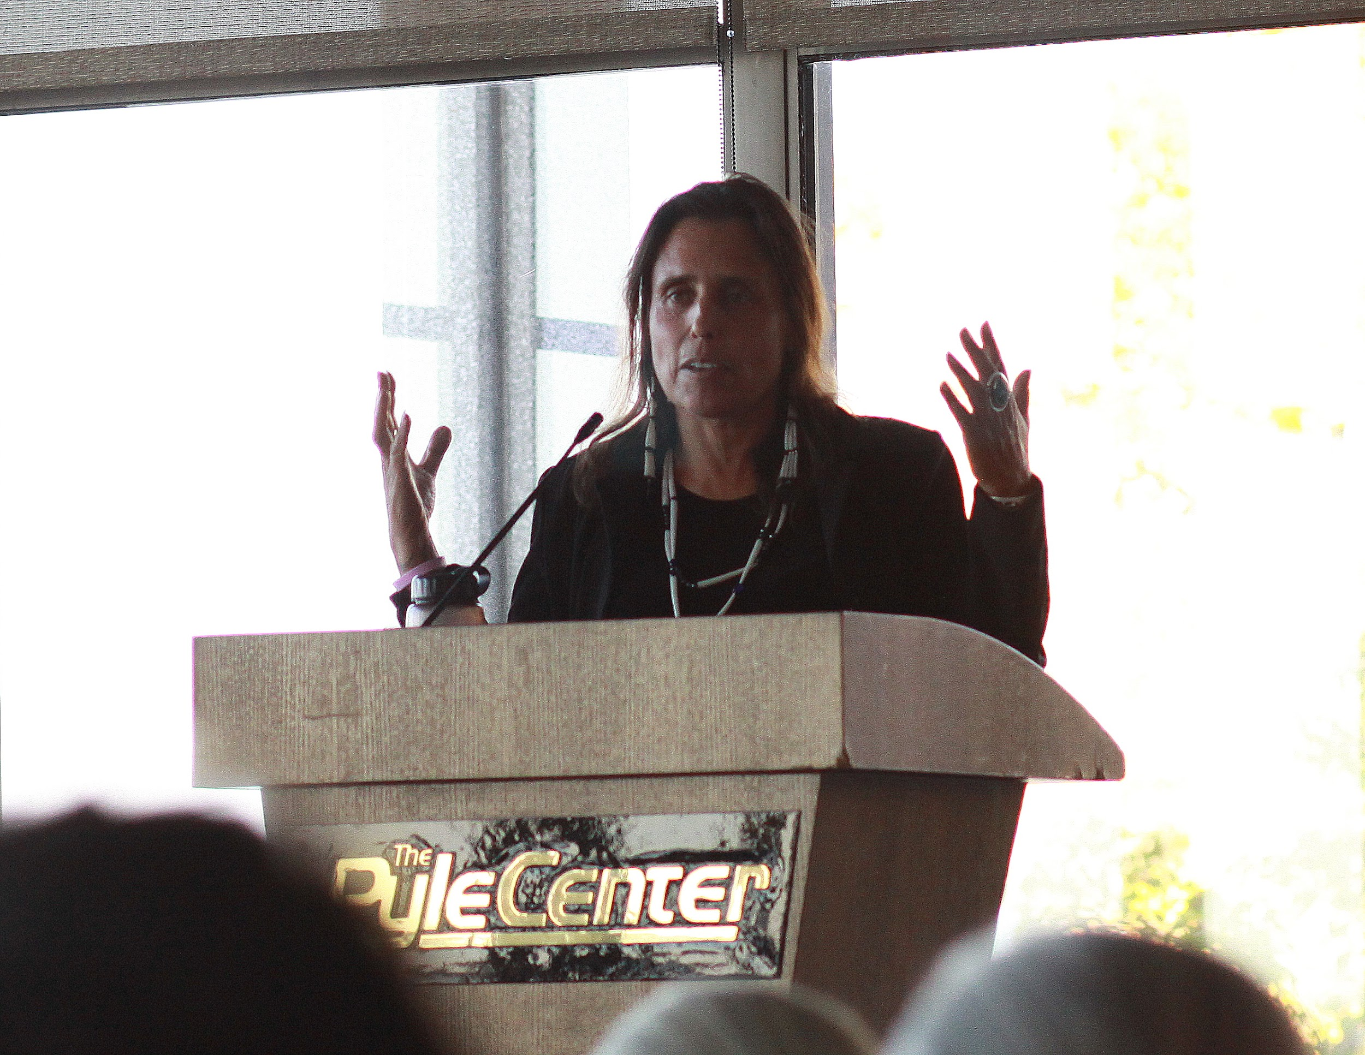
It is time to reach back and learn and teach the true history of science through all perspectives.
Teaching history is a way of honoring the past and learning from it. Our past is not being honored when omissions are made to make the colonizers look better than they were and the one’s whose lands were stolen from look worse than they are.
Indigenous people are still here and Indigenous scholars have much knowledge to share.

Slide 23
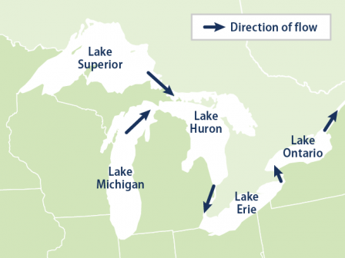
Gitche Gumee and the Great Lakes
The Decolonial Atlas
Notes:
Explain how I have always been connected to the Great Lakes.

Slide 24
The Great Lakes had names already before the colonizers arrived.

Slide 25
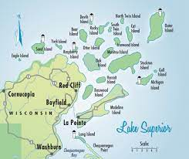
Minisan – Website- Connecting Ojibwe Ecological Knowledge and Climate Change in the Apostle Islands

Slide 26
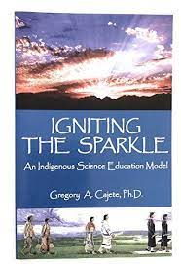
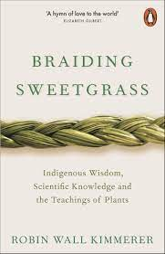
My intent is to ally and co-conspire with Indigenous voices to learn from and enhance my science teaching content.
Notes:
Great Lakes Water Wars

Slide 27
When we research it is with love to pass on information to our students to help them make the world a better place.
Notes:
Emphasize how I thank my students each year.

Slide 28
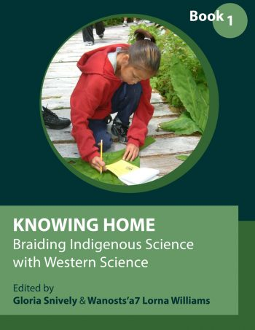
Indigenous Science involves a relationship with nature.
In developing a framework for Indigenous Science education, we explore the assumptions and beliefs that form the basis of an Indigenous worldview. The concept of “coming to know” is a term used to describe the process of developing understanding in Indigenous Science (Cajete, 2000; Colorado, 1988; Peat, 1994). Peat describes coming to know as “entering into relationship with the spirits of the people” (p. 65). Coming to know reflects the idea that understanding is a “journey, a process, a quest for knowledge and understanding” with all our relations (Cajete, 2000, p. 66) and there are responsibilities attached to the application and sharing of this deep understanding.
Notes:
Deep Ecology and Ecofeminism

Slide 29
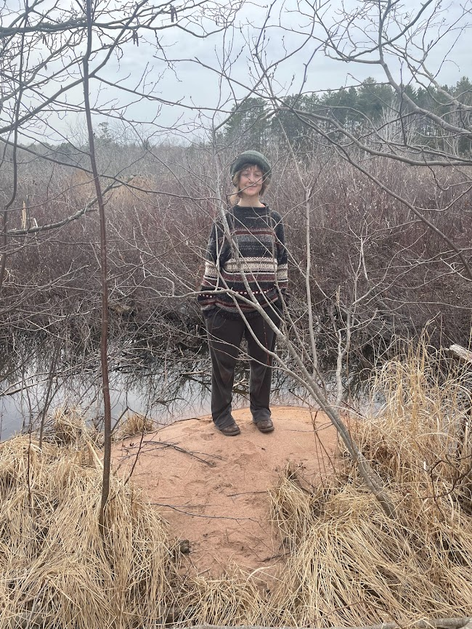
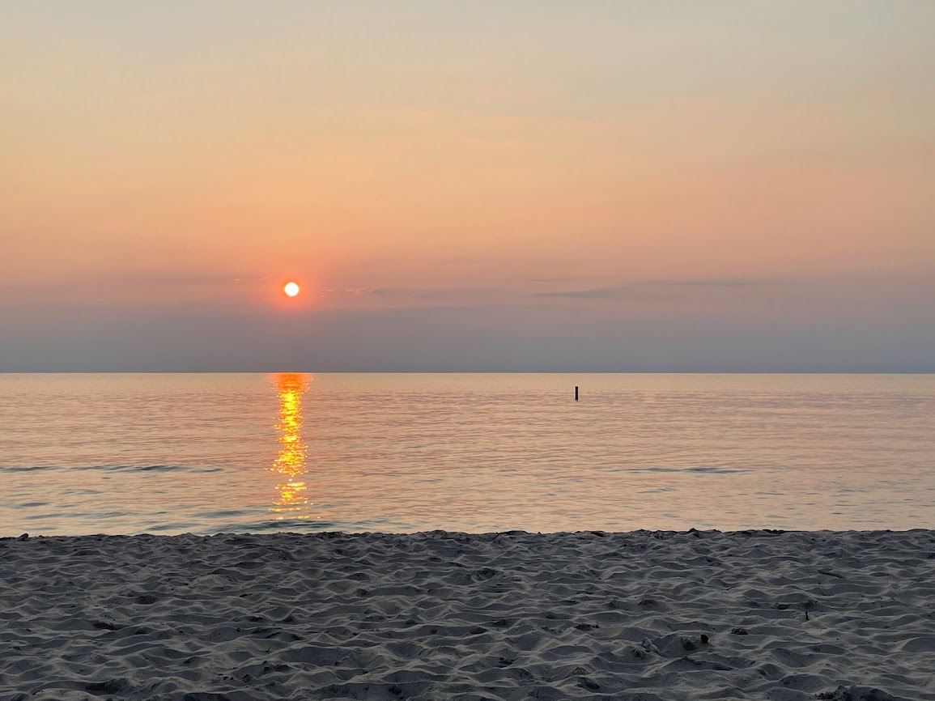
You are part of Nature and Nature is part of you.

Slide 30
Mitakuye Oyasin – We are all related – It reflects the Lakota view of Interconnectedness.
Notes:
On my desk at work.

Slide 31
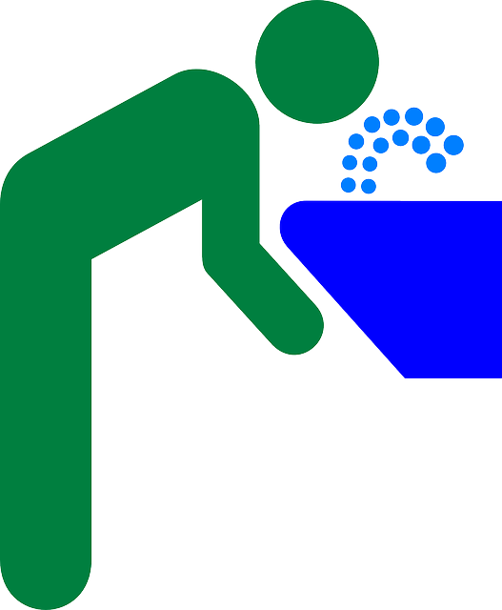
Why are the Great Lakes important?
As adults is important to understand the back story and importance that we make clear to younger generations the importance of preserving natural resources.
According to NOAA…..
Illinois, Indiana, Michigan, Minnesota, New York, Ohio, Pennsylvania, Wisconsin
The Great Lakes span 4,530 miles¹ of coast and account for 21 percent of the world’s freshwater. More than 30 million people rely on the Great Lakes for drinking water—10 percent of the U.S. population and 30 percent of the Canadian population.²

Slide 32
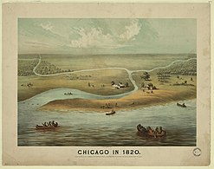
Kittahawa and Jean Baptiste Point DuSable
A Potawatomi woman and a man of Haitian descent were the founders of Chicago in the 1700s.
Notes:
This is an important DEI fact to point out.

Slide 33
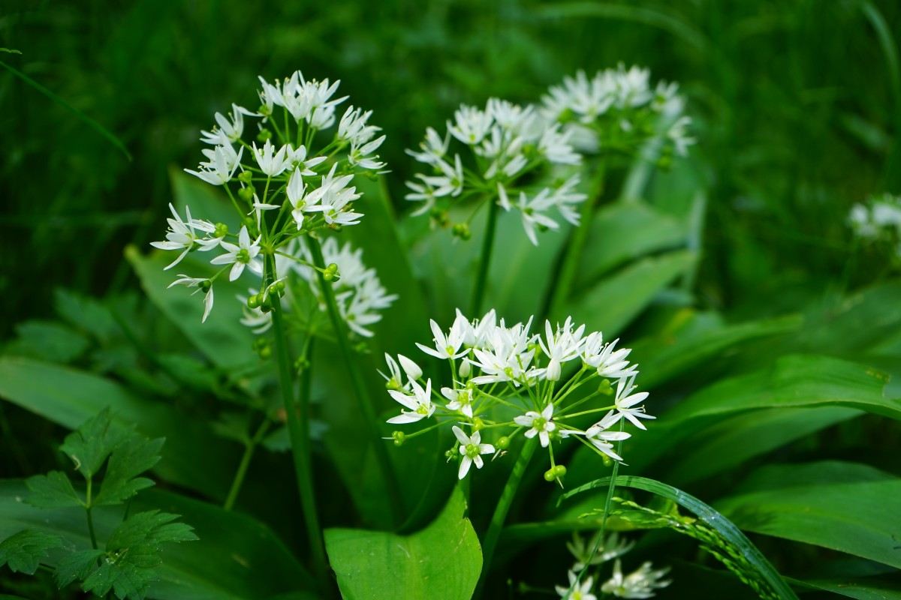
Checagou – Algonquin for the stinky wild leeks
Chicago today has the third-largest urban Indian population in the United States, with more than 65,000 Native Americans in the greater metropolitan area and some 175 different tribes represented.
Hautzinger, D. (2020, September 25). "we're still here": Chicago's Native American Community. WTTW Chicago. Retrieved February 23, 2023, from https://interactive.wttw.com/playlist/2018/11/08/native-americans-chicago
Notes:
Also called wild ramps.

Slide 34
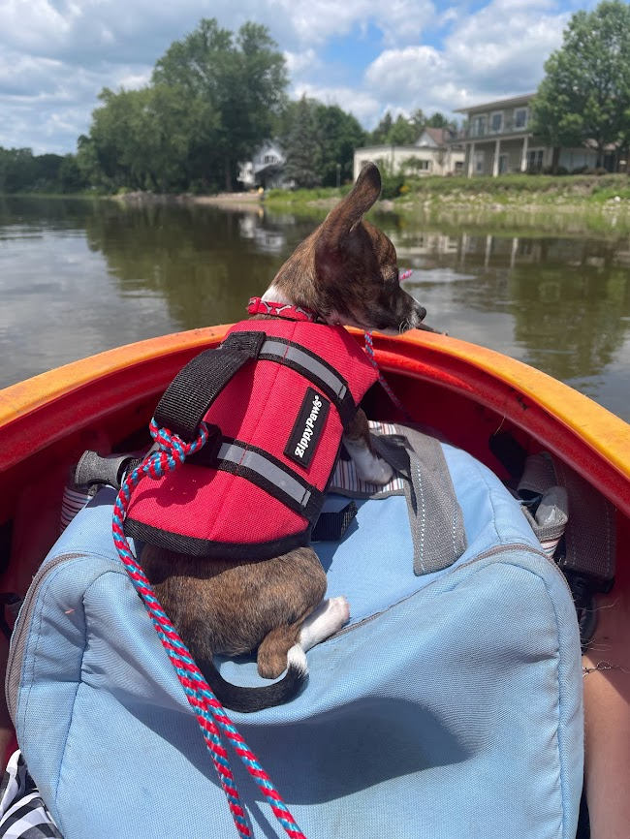
Children’s Literature
As a high school teacher that is a former pre-school teacher I have incorporated the principles of early learning to teaching high school.
Using hands on techniques and a sense of wonder.
Using children’s books I have my students develop lessons for grade school students.
Why do this?

Slide 35
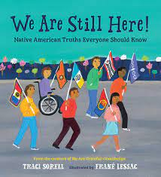
“We are still here.”
https://theways.org/map.html
Map of current tribal land in the Great Lakes Region.
Notes:
Expand on the Trickster Cultural center and our conversation.

Slide 36
This book tells the story of Starved Rock. Also, the origin story of how the Ojibwe came to the Superior region.

Slide 37
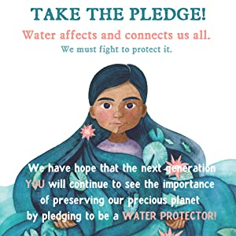
Young people need to learn water does not come from a bottle.

Slide 38
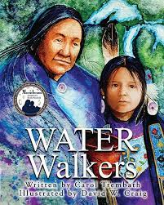
These books are based on the original Water Walkers.

Slide 39
Josephine Mandamin Original Water Walker

Slide 40
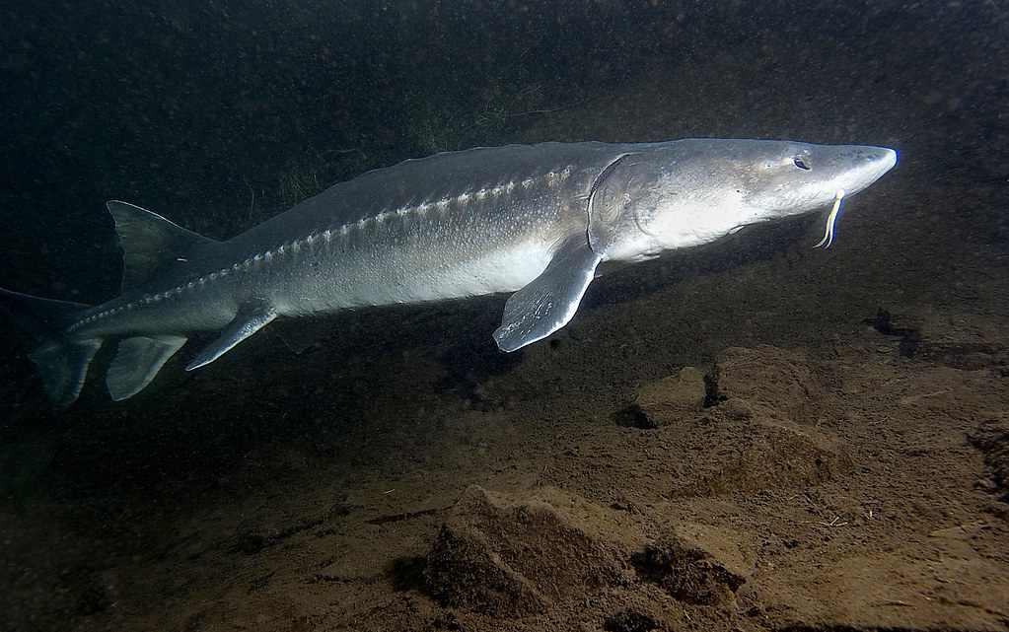
These words were spoken on Turtle Island for 1000s of years before its colonization.
Dakota words
Mni Wiconi (water is life).
m'NEE wee-CHOH-nee
Awake the Film

Slide 41
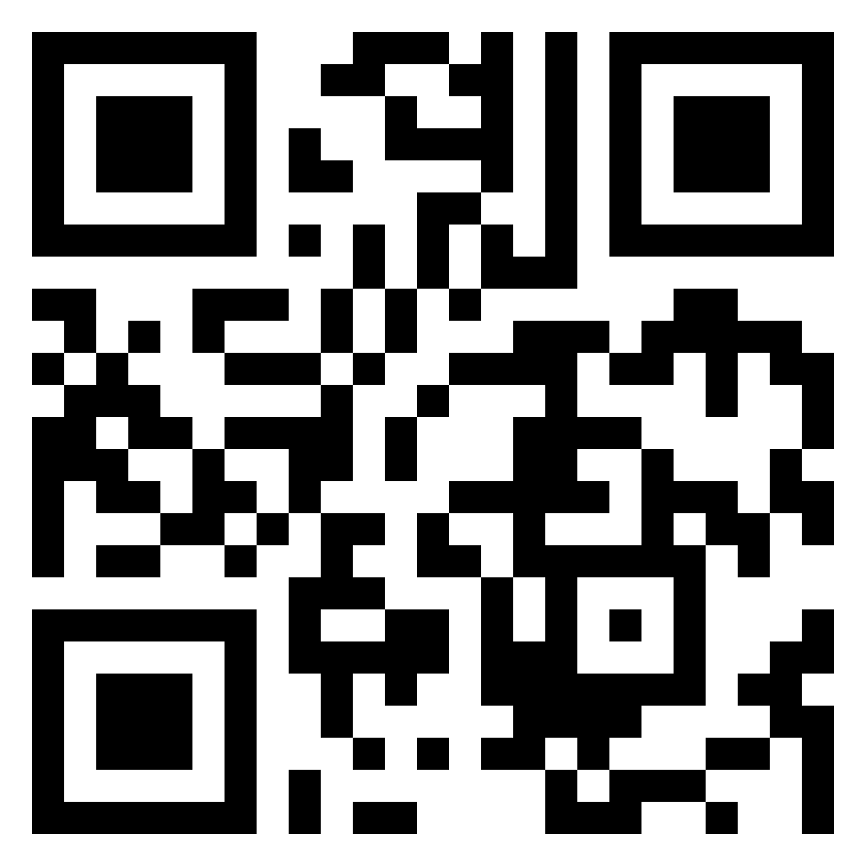
Chabizone.com
Scan the QR code with your phone to obtain more information from my website.
Miigwech - Thank you – Anishinaabemowin
Thank you A-ya-qui-Bogs and “Cherokee Sally” my 4th and 5th Grandmothers who are calling me to do this research.

